Slide 1
Extreme Multipurpose Android App
Supervised by:
KAZI SAEED ALAM
MD. MEJANUR RAHMAN MEZAN (1607105)
MD. ASFI RAIYAN (1607119)

Slide 2
INTRODUCTION
Now A Days People Search For Comfort In Their Daily Life. Many Developers Build Multipurpose App For People To Make Their Daily Life Easier. So Taking Consideration Of This Case, We Want To Develop An Android App Which Would Help Us To Transport One Place To Another By Calling Cars, Bikes And Order Our Food From Restaurants And Deliver Our Parcels to Desired Destination.

Slide 3
OBJECTIVES
App Based Solution For Ride Sharing
App Based Solution For Food Delivery
App Based Solution For Parcel Delivery
Cash On Delivery Payment
Real Time Communication Between Rider & User
Reduce Time Consumption

Slide 4
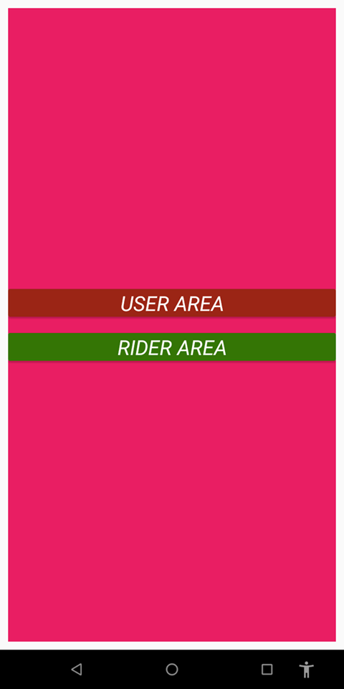
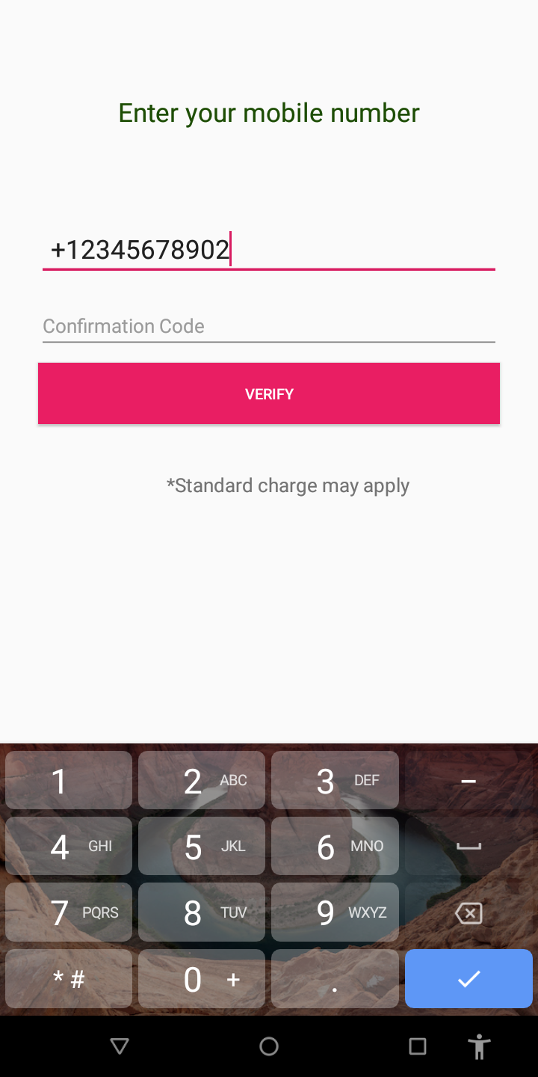
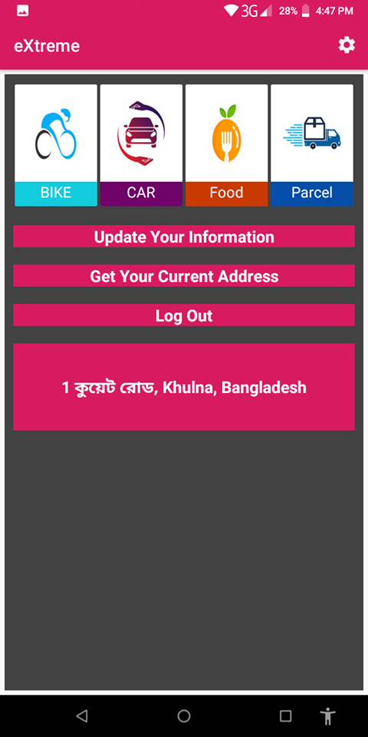
Work Flow

Slide 5
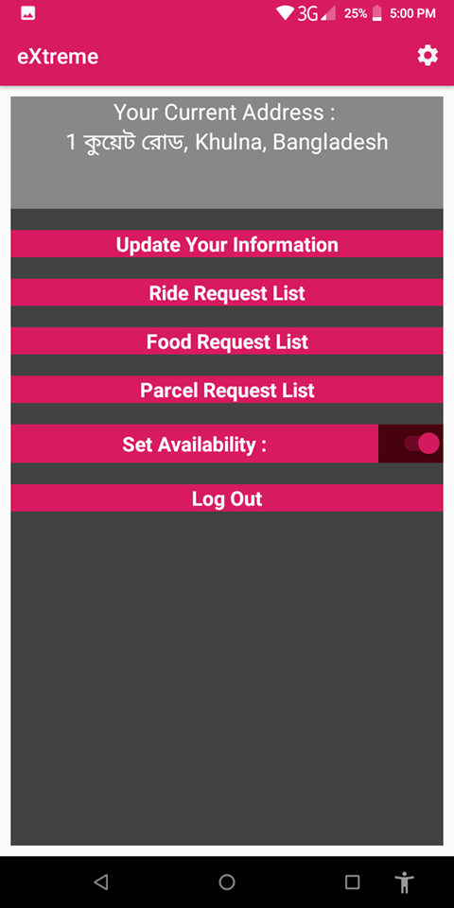
Work Flow

Slide 6

Work Flow

Slide 7
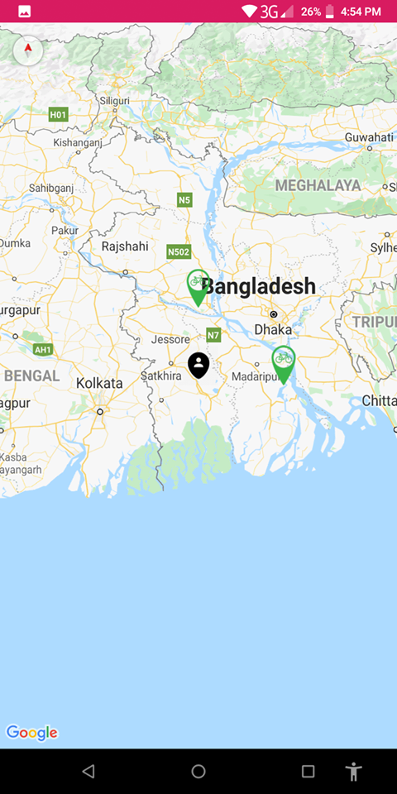
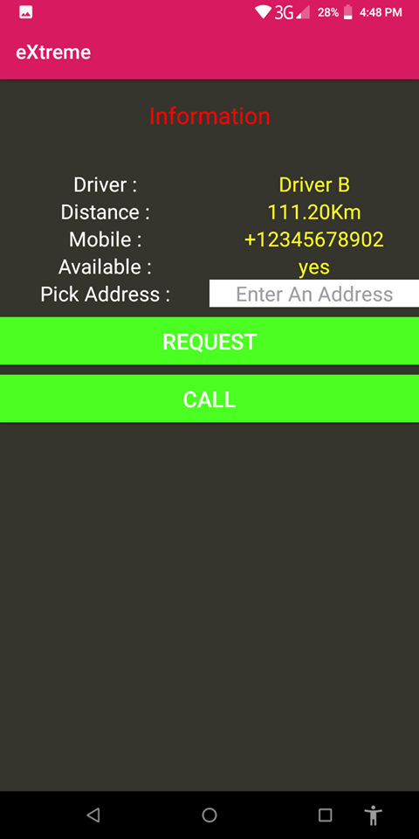
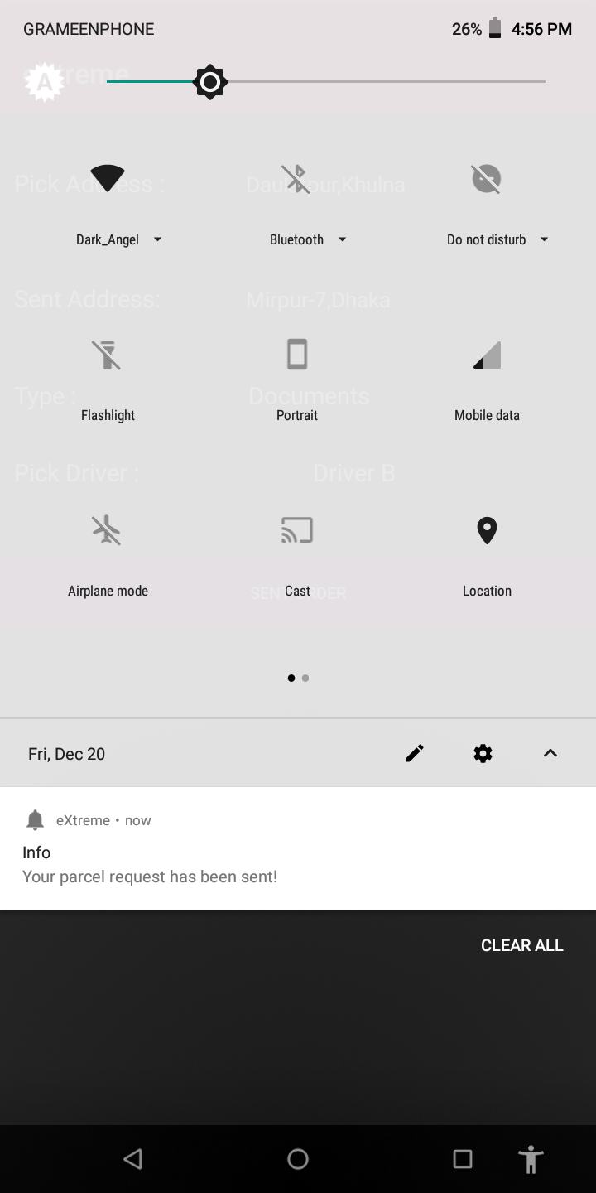
WORK FLOW

Slide 8
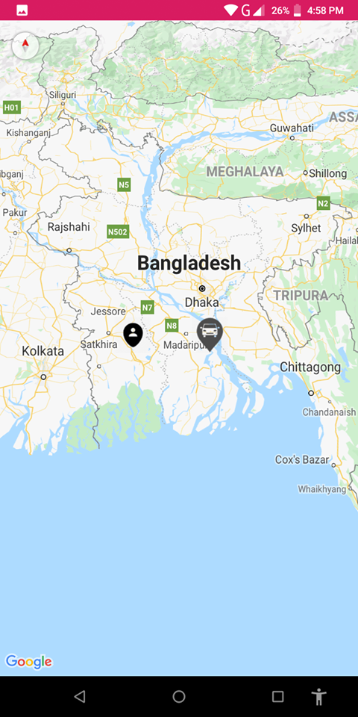
WORK FLOW

Slide 9
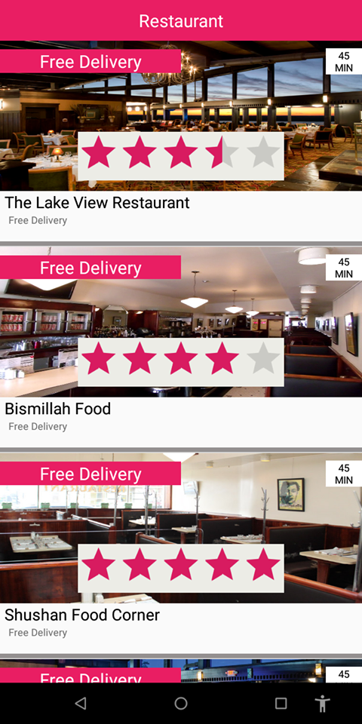
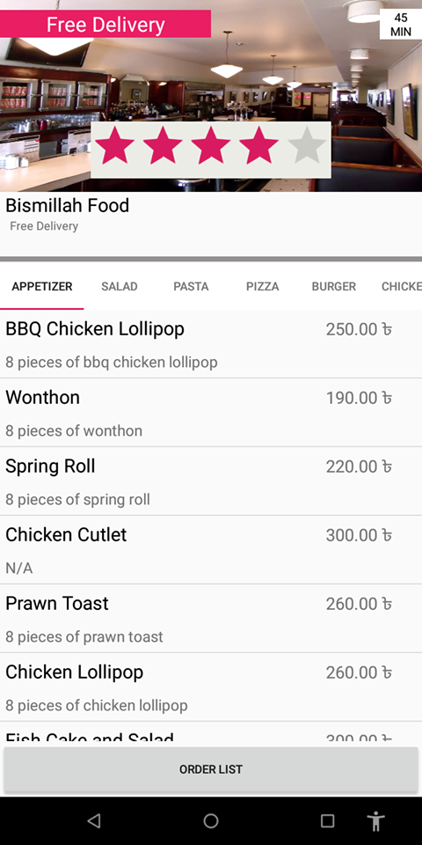
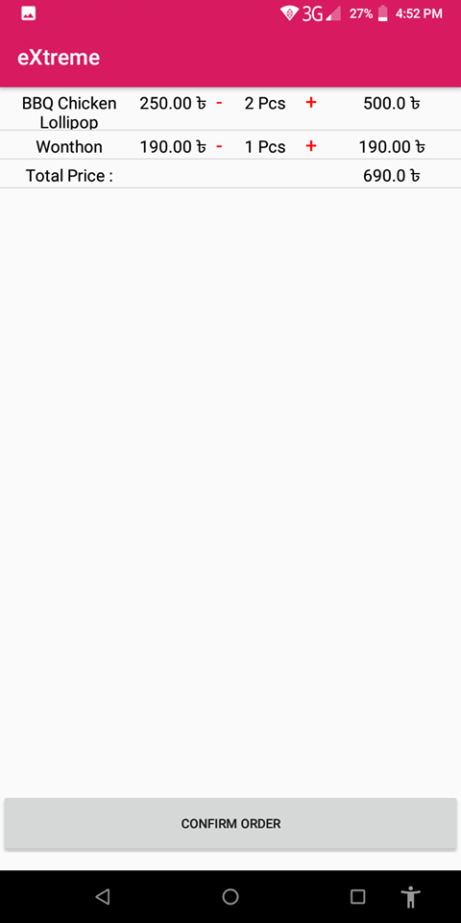
WORK FLOW

Slide 10
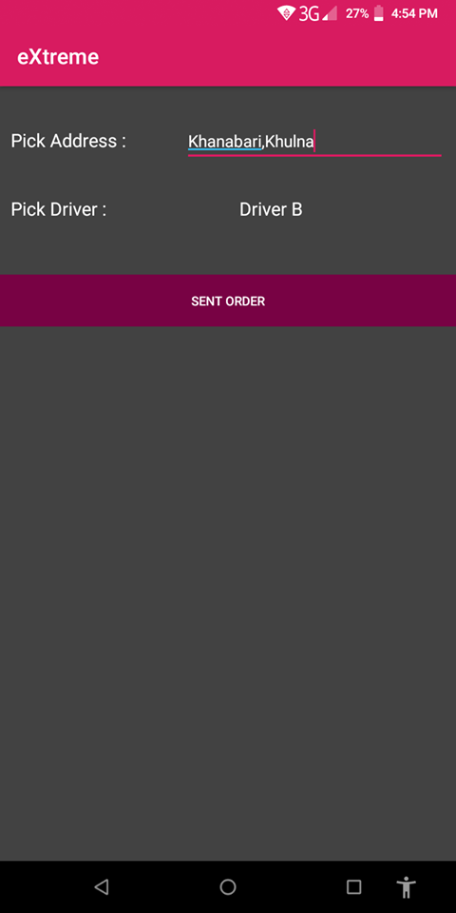
WORK FLOW

Slide 11
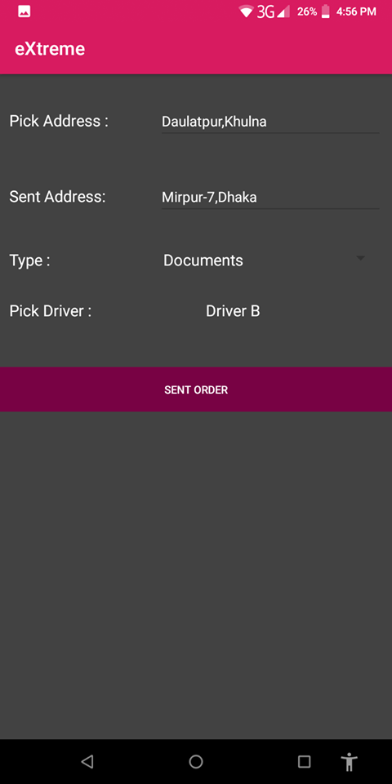
WORK FLOW

Slide 12
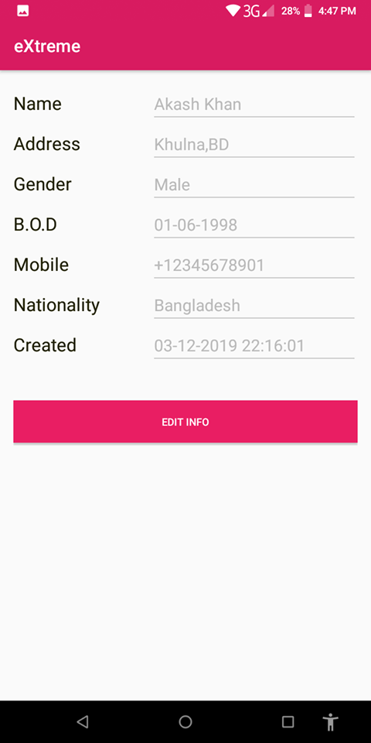
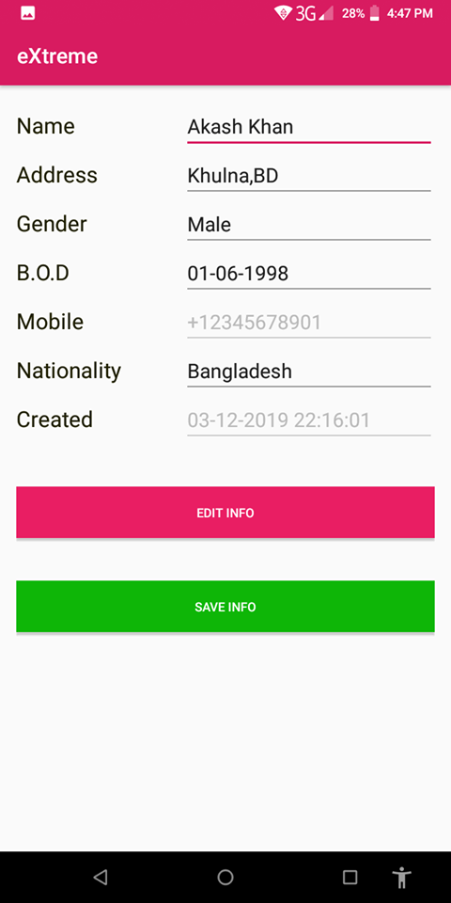
WORK FLOW

Slide 13
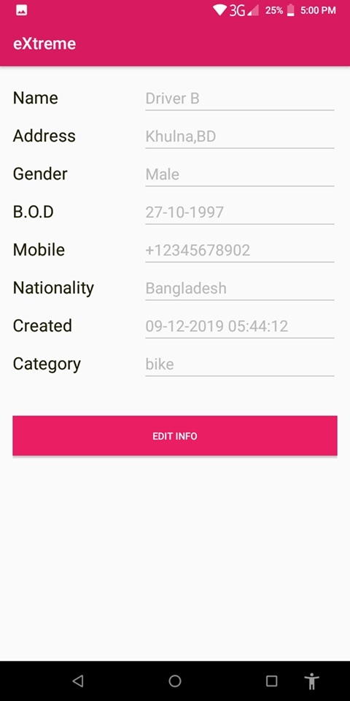
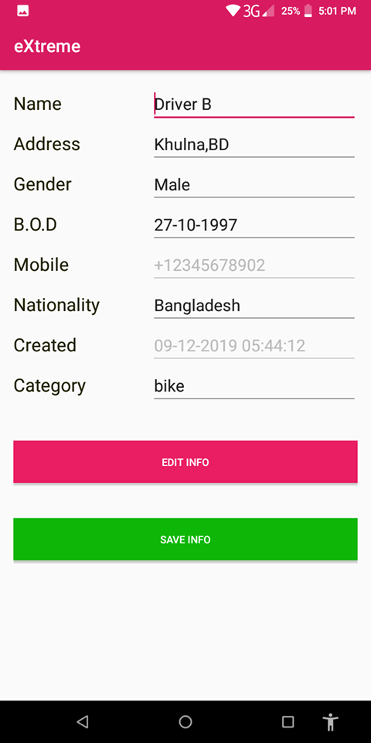
WORK FLOW

Slide 14
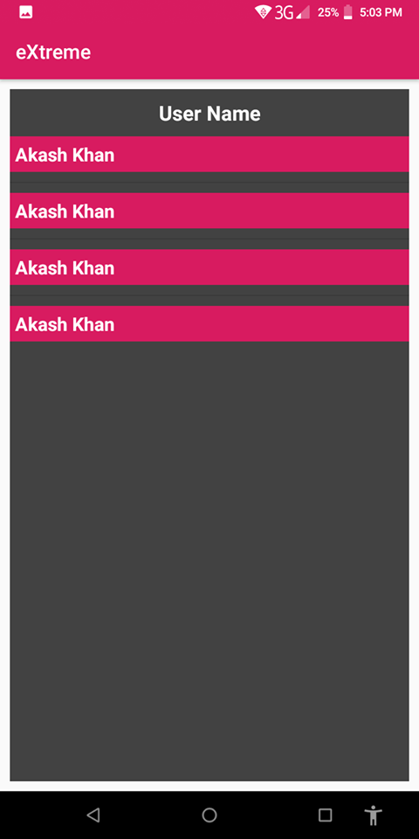
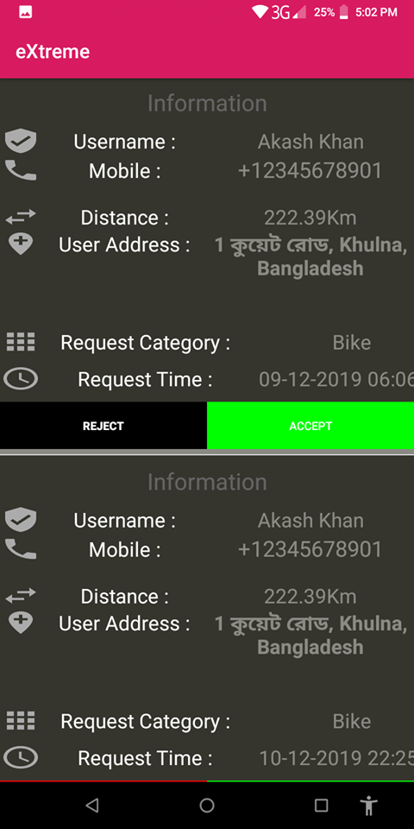
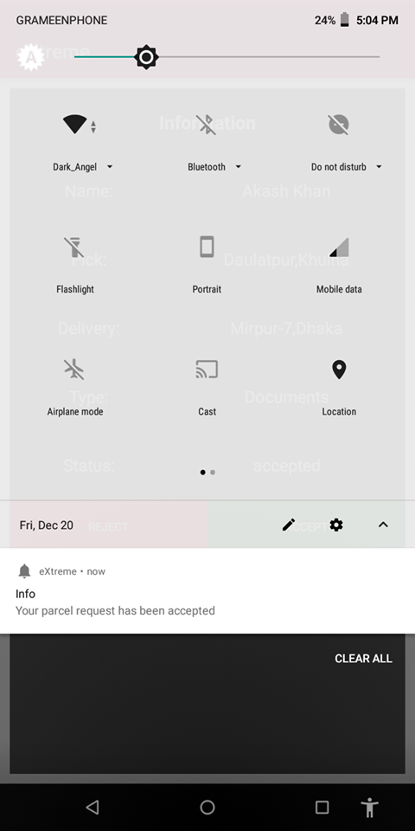
WORK FLOW

Slide 15
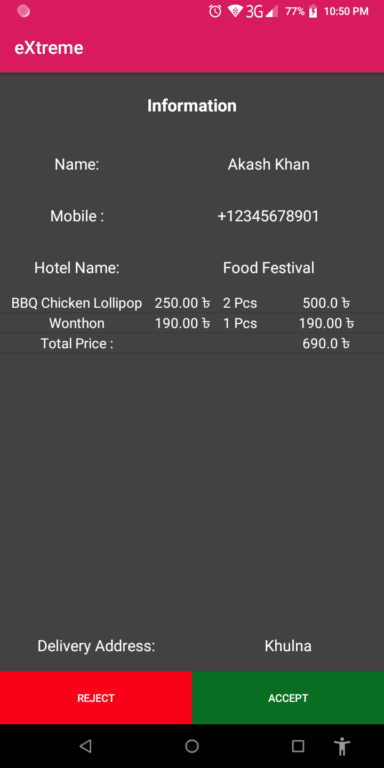
WORK FLOW

Slide 16
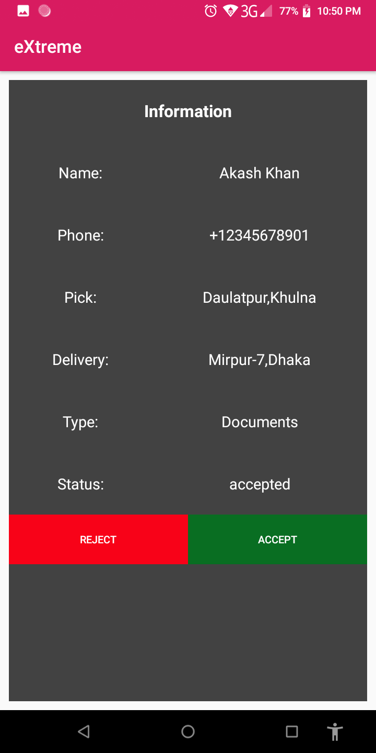
WORK FLOW

Slide 17
REQUIREMENTS
Android Device (Minimum Version 4.1 – Jelly Bean)
Active Internet Connection
Basic User Experience In Android Application
Active Sim Card For Communication

Slide 18
LIMITATIONS
Lack Of Online Payment Method
Lack Of Paid Google Map API (Direction Path)
Lack Of Paid Google Map API (Fixed Area)
Lack Of Messaging Facility In App

Slide 19
FUTURE PLAN
We Want To Add The Direction API in Google map, Add Online Payment Method. Finally, Upload the App in Play Store And Launch Our Startup Business.

Slide 20
REFERENCE
Course : Advanced JAVA Programming Laboratory
Firebase Documentation
One Signal Documentation
Google Map API Documentation

Slide 21
THANK YOU

